Slide 1

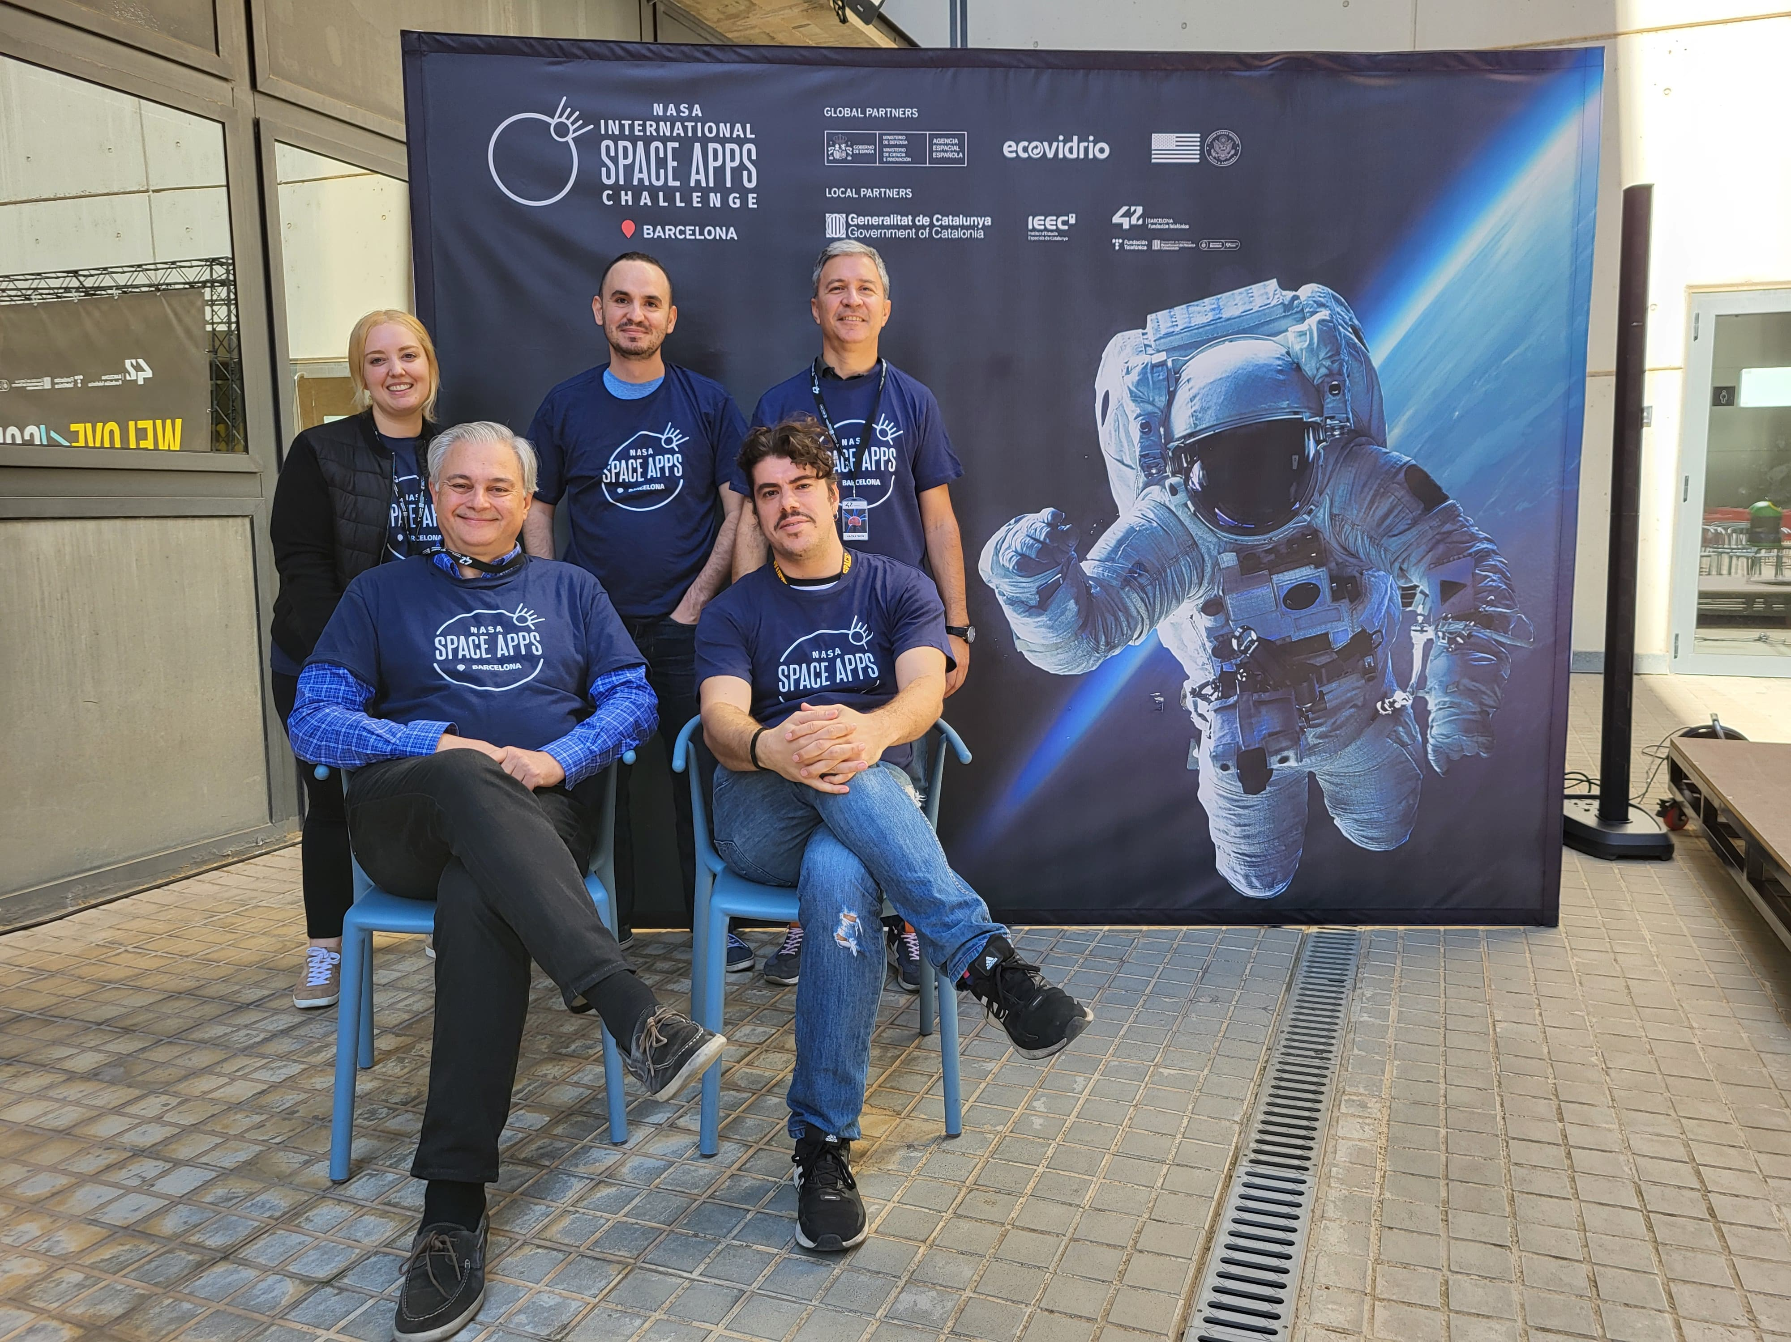

Slide 2
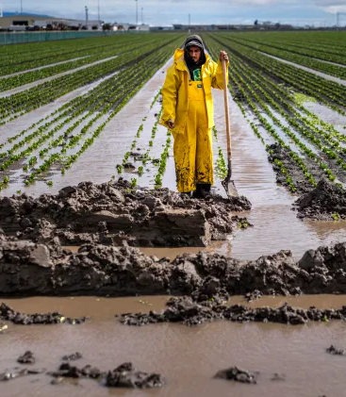
Why pick the Agricultural Decision Making challenge?
In today’s world, we suffer:
Unpredictable weather
Pests
Deseases
Which directly affect farmers:
Planting and harvesting schedules are disrupted
Crops are damaged
Livestock becomes sick
This means that all of us are affected, because crops and livestock are a critical source of food.
Credit: Getty Images

Slide 3
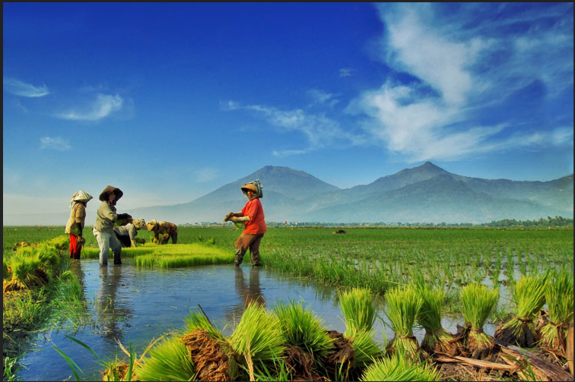
Why pick the Agricultural Decision Making challenge?
Within this context, Farmers need support by means of improved weather data and predictions (more precise, timely, adapted to their specific crops / livestock)
This support will enable farmers to:
Make informed decisions based on relevant, useful, actual data
Manage the risks of drought and floodings and use water efficiently
Improve their farming practices
Optimize production
In turn, this contributes to a steady supply of food, which benefits both farmers and consumers (predictable deliveries, stable prices).
Credit: nooreva

Slide 4
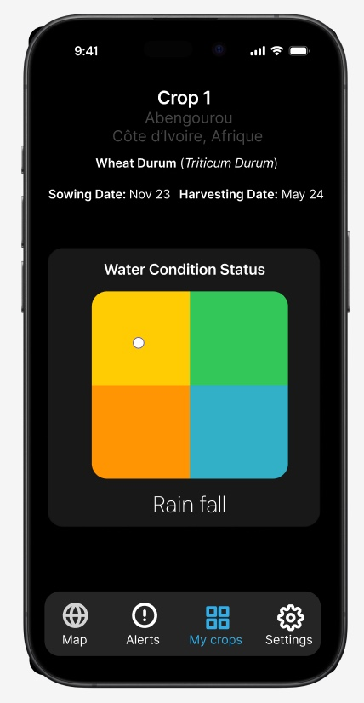
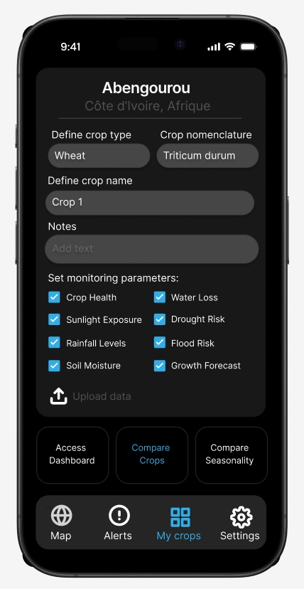
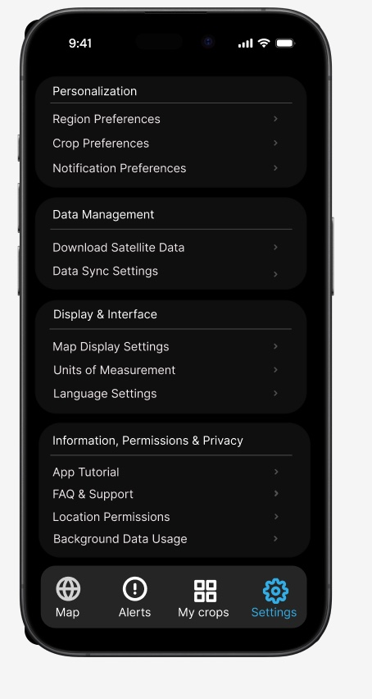
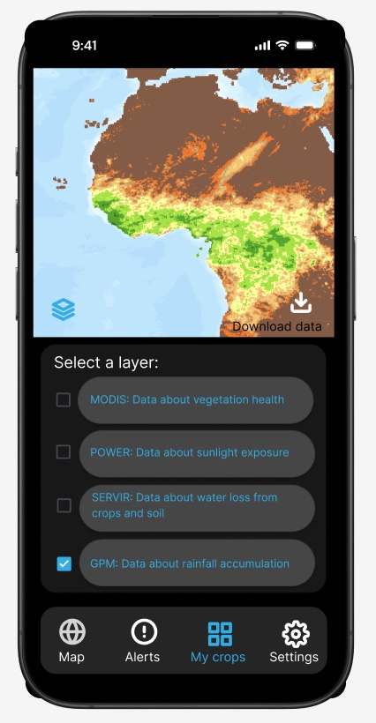
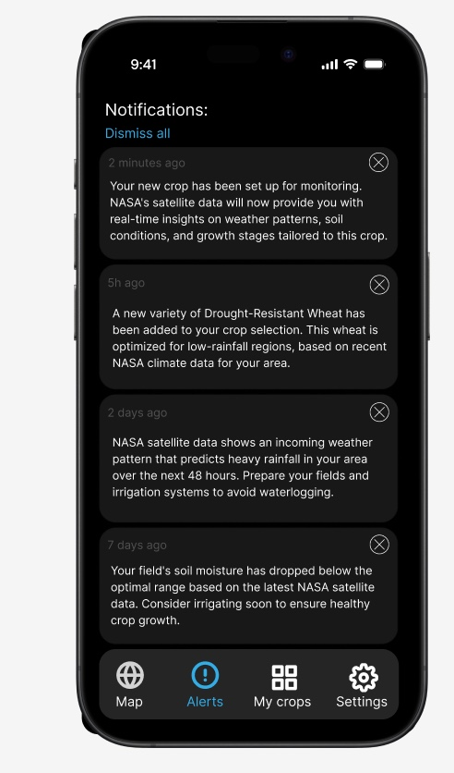
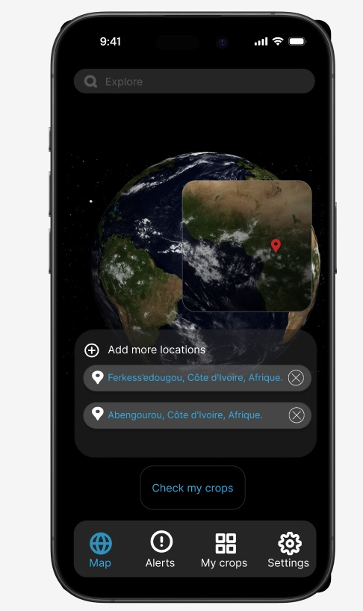
How to address the challenge and what to do?
NASA and other Space Agencies have a wealth of information.
We will publish that information in a way which is accessible and understandable to farmers, by means of an app.
With:
User-friendly interface
Dashboard
Sourcing data not only from the Space Agencies, but from the farmers themselves as well

Slide 5
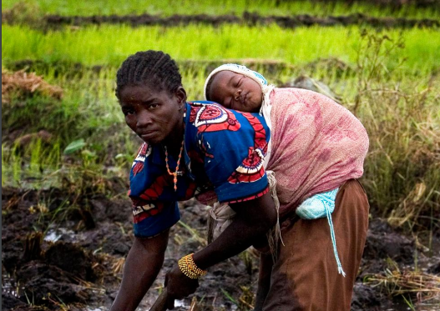
Who will use it?
The app will be available to different people with different perspectives:
Farmers (520 million people, around 50% women, less than 10 hectares)
Agronomists
Soil scientists
Laborers
Agricultural communities
We need to bear in mind that more than 1/3 of adults in Southeast Asia and Sub-Saharan Africa cannot read.
On the other hand, the app will also support exchanging messages among people and the use of discussion forums.
Credit: FAO

Slide 6

Critical Success Factors
We consider the following points as most relevant:
Farmer centric design, i.e. base the app on the users and their specific needs
Translate complex data into clear and understandable information
Timely updates and offline availability for away locations with no connectivity or low speed connectivity
6

Slide 7

Q&A

